Slide 1




A Safer Way to Prescribe Medications: A MA-Based Project to Incorporate Indications into Electronic Prescriptions
MA Coalition for Prevention of Medical Errors
May 4, 2018
Gordon Schiff, MD
Associate Professor of Medicine, Harvard Medical School
Associate Director, Brigham and Women’s Center for Patient Safety Research and Practice
Quality and Safety Director Harvard Medical School Center for Primary Care
Pamela Garabedian, MS
Project Specialist - Human Factors/User Experience Researcher, Brigham and Women’s Hospital and Partners HealthCare

Slide 2
Conflict of Interest
Gordon Schiff, MD
Pamela Neri Garabedian, MS
No real or apparent conflicts of interest to report.
Indications Project Funded by U.S. Agency for Healthcare Research and Quality AHRQ HIT Safety Grant HS23694

Slide 3
Agenda
Background & rationale - Brigham AHRQ Indications Rx project
Summarize activities and findings from project aims 1-3
Demonstrate BWH prototype
Results of prototype testing
  Comparisons with Epic and Cerner
Next steps
  How might “indications first” be incorporated into EMR?
  How can we move forward with this?

Slide 4

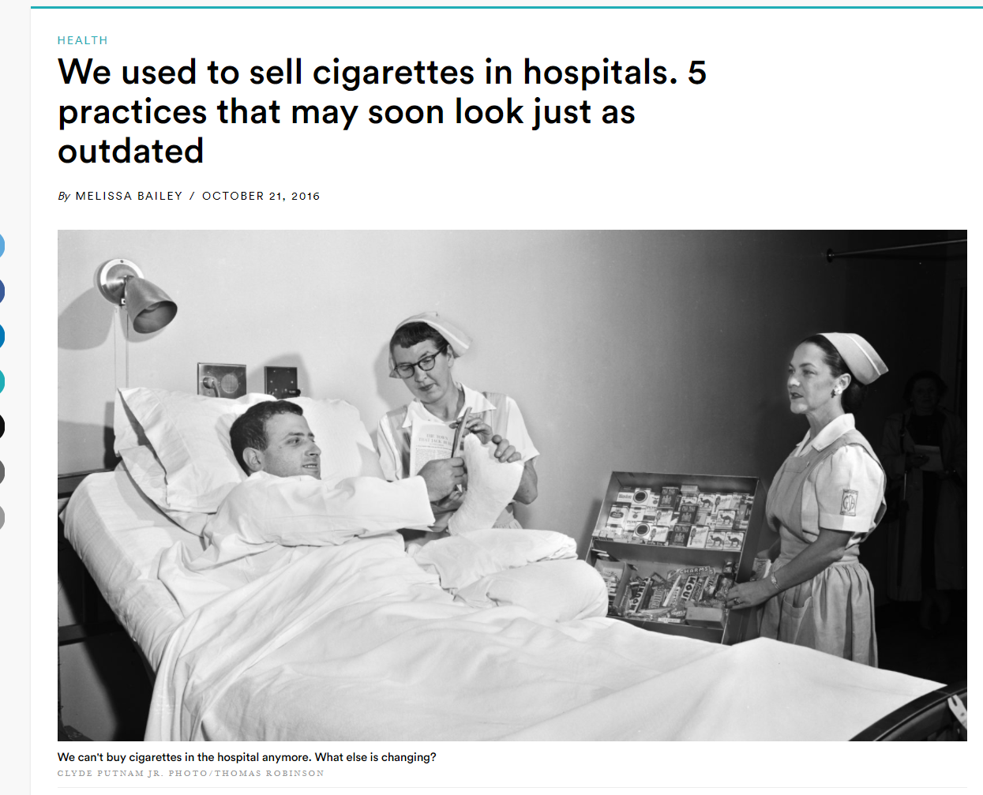

Slide 5
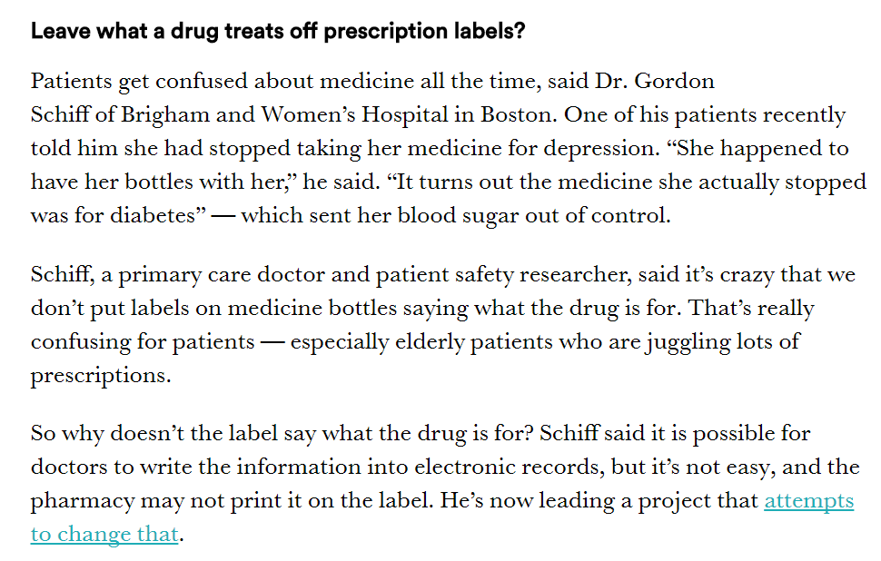

Slide 6

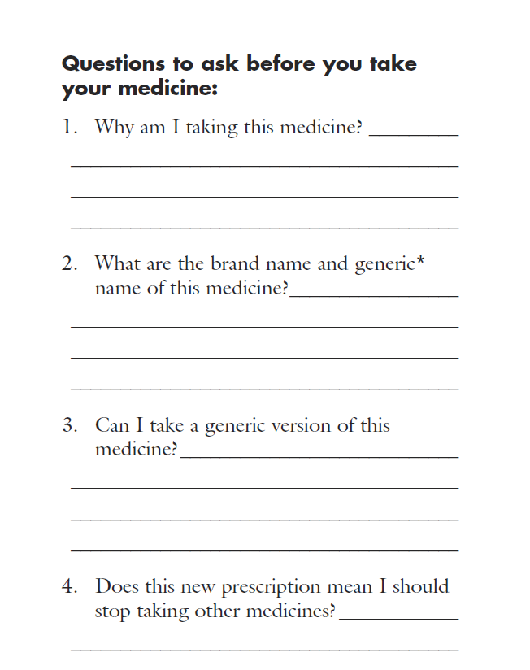


Slide 7

Indications-based Prescribing Major Links to 4 AHRQ HIT Safety Emphasis Aims, Central to Key Functions
User-centered design, human factors principles
applied to HIT safety
Policy to impact decisions on the safe use clinical HIT
Safety
Patient
Education
Drugs of Choice
Design, implement
usable safe HIT
for all users,
including patients
Use HIT socio-technical systems to improve safety
Team Communication
Med Reconciliation
QI
Effectiveness
Research

Slide 8
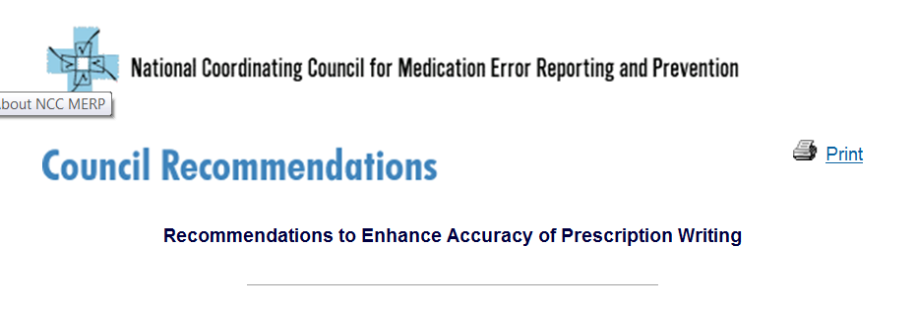
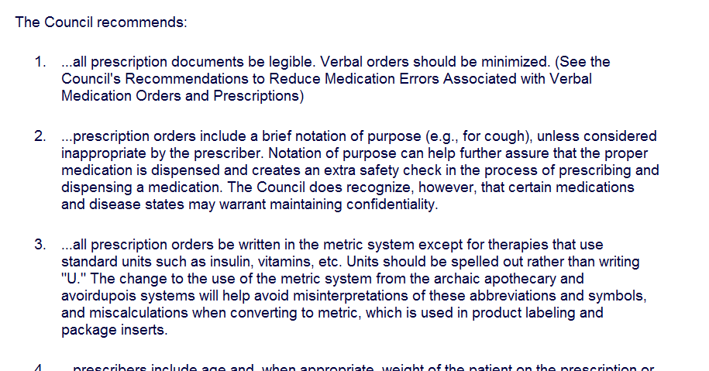
http://www.nccmerp.org/council/council1996-09-04.html

Slide 9
Overall AHRQ Project Aim
“To improve prescribing safety by redesigning medication computerized prescriber order entry (CPOE) by incorporating the medication indication into the prescription order.”

Slide 10
3 Year Project Specific Aims
Convene 6 stakeholder expert panels on rationale, multi-user needs, operational and interoperability requirements, interface design elements, limitations and barriers, and policy implications of incorporating indication into CPOE; publication of Sounding Board and White Paper
Build working prototype indications-enabled CPOE using user-centered design incorporating Aim 1 recommendations
Formally test and compare prototype to two widely deployed CPOE systems using use-case clinical scenarios re: ordering speed, error rate, user experience/satisfaction, plus usefulness and safety of the prescriptions generated for pharmacists and patients.

Slide 11
Participating Stakeholders’ Organizations
AbbVie
Academy of Managed Care Pharmacy
Accreditation Council for Graduate Medical Education
Agilex
AHRQ
Albany Medical Center
American Academy of Family Physicians
American Association of Colleges of Pharmacy
American Board of Internal Medicine
American Cancer Society
American College of Physicians
American Heart Association
American Medical Association (AMA)
American Pharmacists Association (APhA)
American Society of Health Systems Pharmacists
Anthem Blue Cross Blue Shield
Ashleigh Fisher Consulting
Athenahealth
Baptist Healthcare System
Baton Rouge General Hospital
Baylor College of Medicine
Becton Dickinson and Company
Betsy Lehman Center for Patient Safety and Medical Error Reduction
Boesen & Snow LLC
Boston Children's Hospital
Brigham and Women's Hospital
California State Board of Pharmacy
Catamaran
Centers for Disease Control and Prevention (CDC)
Centers for Medicare & Medicaid Services (CMS)
Cerner
Cincinnati Children's Hospital Medical Center
CMI Project
Colcamex Resources
Cone Health
Consumer Reports
CVS Caremark
CVS Health
Dartmouth College
Department of Health and Human Services Office of the National Coordinator for Health IT
District of Columbia Board of Pharmacy
DrFirst
Duke University

Slide 12
Participating Stakeholders’ Organizations
Elsevier Clinical Solutions
Emedeon
Enhance Value
Epic
Epilepsy Foundation of America
Fairview Pharmacy Services
First Data Bank (FDB)
First DataBank
Food and Drug Administration (FDA)
Genelex
Government of Western Australia Department of Health
Granada Health, LLC
Harvard Medical School
Harvard Primary Care Center
Healthcare Compliance Packaging Council
Healthy Motivation
Hearst Magazine
Indian Health Service
Indiana University
Institute for Healthcare Improvement
Institute for Safe Medication Practices (ISMP)
International Medical Interpreters Association
International Pharmaceutical Federation
Johns Hopkins University
Kaiser Northwest
Kaiser Permanente
King Fahad Medical City
Kroger
Lee Memorial Health System
Massachusetts College of Pharmacy and Health Sciences University (MCPHSU)
Massachusetts General Hospital
Massachusetts Pharmacy Association
Mayo Clinic Rochester
McKesson
Memorial Pediatrics
Merck & Co., Inc.
Midwestern University
Molina Healthcare
Molina Medicaid Solutions
Montefiore Medical Center
National Academy on an Aging Society
National Alliance of State Pharmacy Associations
National Association of Boards of Pharmacy (NABP)
National Association of Chain Drug Stores

Slide 13
Participating Stakeholders’ Organizations
National Association of Managed Care Physicians
National Community Pharmacists Association
National Council on Patient Information and Education (NCPIE)
National Osteoporosis Foundation
National Patient Safety Foundation
NCPDP
New York State Board of Pharmacy
NextGen Healthcare
Northwestern University
Ohio Pharmacists Association
Ohio Public Employees Retirement System
Oklahoma Health Care Authority
Omnicare, Inc.
OPERS Healthcare
Optum
OptumInsight, Inc.
Oregon Health and Science University
Osterhaus Pharmacy
Partners Healthcare
Patient Safety America
Patients for Patient Safety Canada
Patients Like Me
PDX Inc
Pfizer
Pharmaceutical Research and Manufacturers of America
Pharmacy HIT Collaborative
Phil Burgess Consulting
Point-of-Care Partners
Project Patient Care
Purdue Pharma L.P.
Quantros, Inc.
RAND Corporation
Rite Aid
S and R Consulting Associates
Salem Memorial District Hospital
San Francisco State University
Sanofi
South Carolina Pharmacy Association
Spectrum Health
St. David's Round Rock Medical Center
Stratis Health
SUNY Buffalo
Surescripts
Target

Slide 14
Participating Stakeholders’ Organizations
The Joint Commission
The Lynx Group
The Medical Letter
The PSO Advisory
The University of Alcala de Henares
The University of Illinois at Chicago
Truven Health Analytics
Tufts Medical Center
UCL School of Pharmacy, London
UIC College of Pharmacy
UNC School of Pharmacy
Uniformed Services University of the Health Sciences (USUHS)
United States Pharmacopeia (USP)
Universite Catholique de Louvain
Université Laval
University of Alabama at Birmingham
University of Arizona College of Pharmacy
University of British Columbia (UBC)
University of California Los Angeles (UCLA)
University of Colorado
University of Connecticut
University of Edinburgh
University of Illinois - Chicago
University of Maryland
University of Mass Memorial Medical Center
University of Minnesota
University of Pennsylvania
University of Sydney
University of Washington
US Public Health Service
Vanderbilt University
Veterans Affairs
Veterans' Association
Walgreens
Walmart
Weil Cornell Medical College
Wisconsin Department of Health Services
Wolters Kluwer
Wolters Kluwer, Clinical Drug Information
Yale University
York University, Toronto
Zynx

Slide 15
Knowing Medication Indication
Would Prevent These Errors*
Rapamune (immunosuppressant) vs. Rapaflo (BPH). Consequence: organ rejection or progressive BPH
Risperidone (schizophrenia, bipolar disorder) vs. Ropinirole (PD, RLS). Consequence: worsening of symptoms
Tramadol (pain) vs. Trazodone (depression). Consequence: no pain relief or increase depressive mood
Lamotrigine (epilepsy) vs. Lamivudine (HBV or IV). Consequences: seizure or liver failure/AIDS (lamivudine indications are dose dependent)
Prozac (depression) vs. Prograf (transplant rejection). Consequence: organ rejection or worsening of depression
*ISMP List of Confused Drug Names -
ISMP National Medication Error Reporting Program
https://www.ismp.org/tools/confuseddrugnames.pdf

Slide 16
Knowing Medication Indication
Would Prevent These Errors*
Brilinta (antiplatelet) vs. Brintellix (antidepressant). Consequence: bleeding risk or worsening of depression
Chlorpromazine (schizophrenia) vs. Chlorpropamide (DM). Consequence: delusional/hallucinating symptoms or hyperglycemia
Jantoven (anticoagulant) vs. Januvia (DM). Consequences: bleeding risk or hyperglycemia
Keppra (epilepsy) vs. Keflex (infection). Consequences: seizure or worsening of infection
Sulfasalazine (UC, RA) vs. Sufadiazine (infection). Consequence: disease flare/progression or antibiotic resistance/worsening of infection
*ISMP List of Confused Drug Names -
ISMP National Medication Error Reporting Program
https://www.ismp.org/tools/confuseddrugnames.pdf

Slide 17
Clinician Perspective
“Don’t tell me what to do”
  I don’t want anyone taking away my clinical autonomy; especially someone who doesn’t know my patient, or what is best for him or her like I do.
“Just tell me what to do”
  I am so frustrated with all the hassles and back and forth faxes and calls with formulary/nonformulary, prior authorization, multitiered co-payment, that….just tell me what to do and I will do it so I can move on to my next patient and work.

Slide 18
Old Paradigm
Drug

Slide 19
Old Paradigm
Drug
You Must Add an
Indication
Dx/Indication

Slide 20
New Paradigm
Drug
You Must Add an
Indication
Dx/Indication
Flexibly Suggests
Drug of Choice
Drug
Dx/Indication

Slide 21
New Paradigm
Drug
You Must Add an
Indication
Dx/Indication
Flexibly Suggests
Drug of Choice
Drug
Dx/Indication

Slide 22
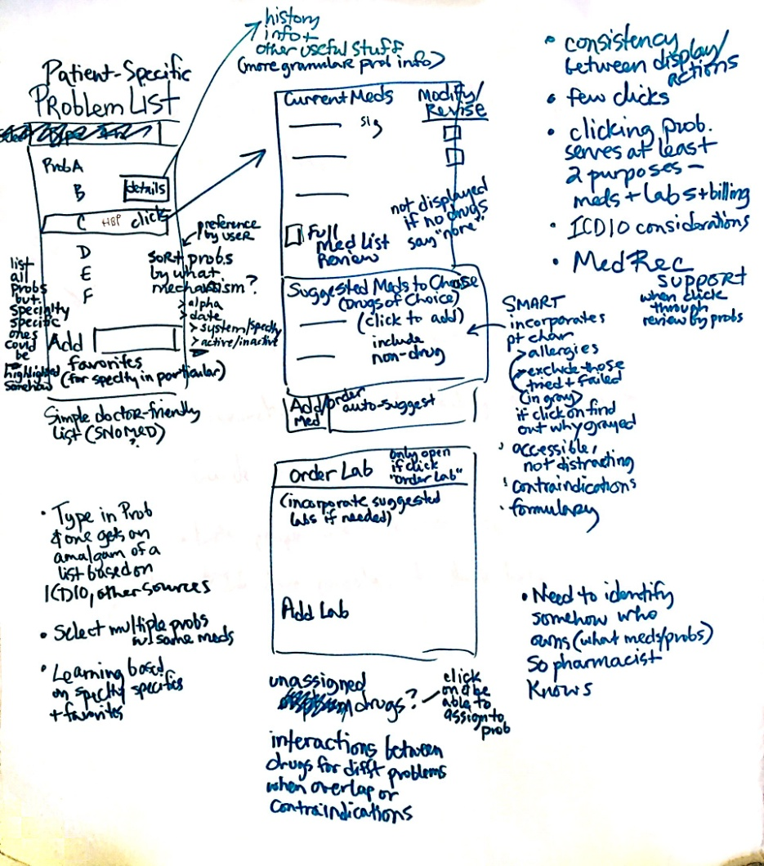
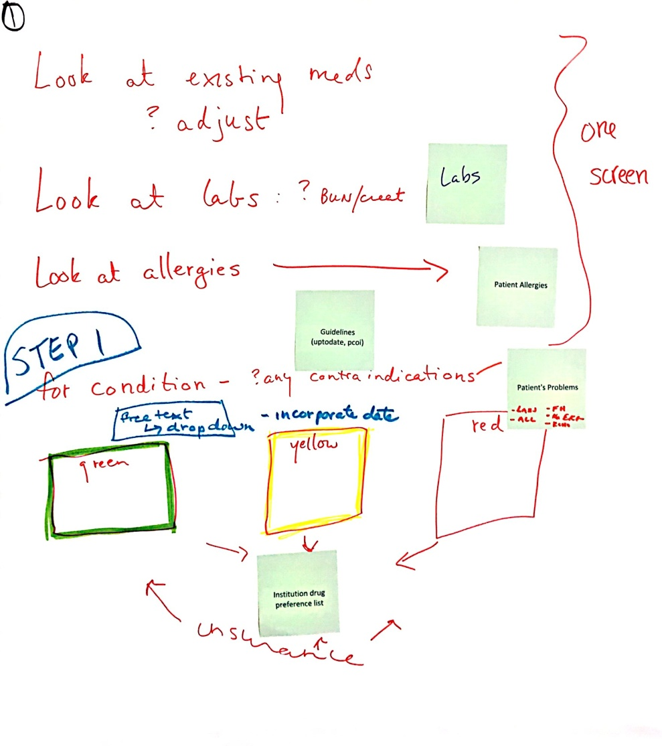
Participatory Design Results

Slide 23
Next Steps
Publicize, publish multiple project studies
  Create interest, will, amongst key players
Work with Epic, Center, other vendors to incorporate
  ? Stand alone vs. integrated “apps” to CPOE
Develop content to support
  Drugs and regimens of choice
  Who/what is “Trusted Source”
Address other challenges, thorny issues
  Diagnosis vs. Indication in Surescripts

Slide 24
Questions?
Gordon Schiff
  E-mail: gschiff@bwh.harvard.edu
Pamela Garabedian
  E-mail: pmgarabedian@partners.org

